Slide 1
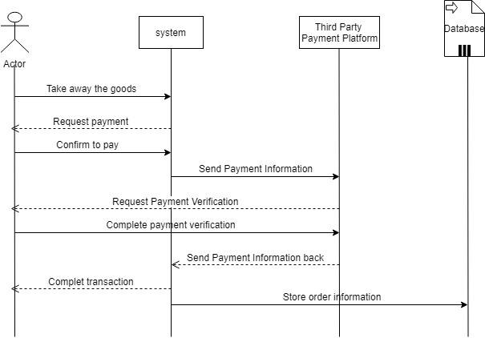
UC-15 Payment
Flow of Events for Main Success Scenario:
--a. The receiver gets the good, and the timer stops timing.
--b. The system confirm the order information, and turn to the payment interface.
--c. The receivers pay money for their using.
--d. The system record the data.

Slide 2
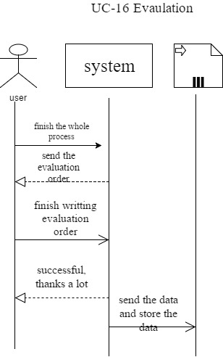
UC-16 Evaluation
Flow of Events for Main Success Scenario:
-a. The users write the evaluations or suggestions to the system.
--b. The system get the information and store it.

